Slide 1
Clustering

Slide 2
Distance between two clusters
Centroid distance between clusters C_{i} and C_{j} is the distance between the centroid r_{i} of C_{i} and the centroid r_{j} of C_{j}

Slide 3
Distance between two clusters
Ward’s distance between clusters C_{i} and C_{j} is the difference between the total within cluster sum of squares for the two clusters separately, and the within cluster sum of squares resulting from merging the two clusters in cluster C_{ij}
r_{i}: centroid of C_{i}
r_{j}: centroid of C_{j}
r_{ij}: centroid of C_{ij}

Slide 4
Cluster Similarity: Ward’s Method
Similarity of two clusters is based on the increase in squared error when two clusters are merged
Similar to group average if distance between points is distance squared
Less susceptible to noise and outliers
Biased towards globular clusters
Hierarchical analogue of K-means
Can be used to initialize K-means

Slide 5
Hierarchical Clustering: Problems and Limitations
Once a decision is made to combine two clusters, it cannot be undone
No objective function is directly minimized
Different schemes have problems with one or more of the following:
Sensitivity to noise and outliers
Difficulty handling different sized clusters and convex shapes
Breaking large clusters

Slide 6
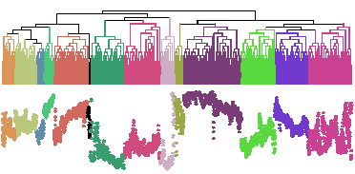
Problems with Dendrogram
Messy to construct if number of points is large.
Number of observations = 6113

Slide 7
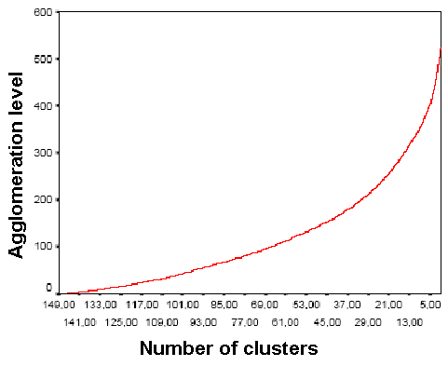
Deciding where to cut the Dendrogram can be difficult
As shown, if there are no sharp elbow knicks in the Inverse Scree Test, then it is difficult to find the number of clusters from the dendrogram
Inverse Scree test

Slide 8
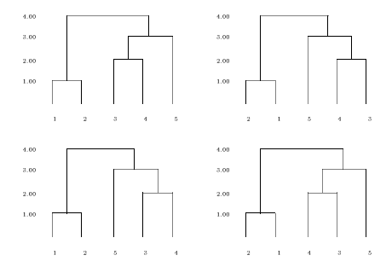

Comparing two Dendrograms is not straightforward
The four dendrograms all represent the same data. They can be obtained from each other by rotating a few branches.
H_{n} denotes the number of simply equivalent dendrograms for n objects.

Slide 9
Clustering Validation & Assessment
Material taken from text book (chapter 8) and from DMA book by Zaki & Meira (chapter 17)

Slide 10
Cluster Validity
For supervised classification we have a variety of measures to evaluate how good our model is
Accuracy, precision, recall
For cluster analysis, the analogous question is how to evaluate the “goodness” of the resulting clusters?
But “clusters are in the eye of the beholder”!
Then why do we want to evaluate them?
To avoid finding patterns in noise
To compare clustering algorithms
To compare two clusters

Slide 11
Clusters found in Random Data
Random Points
DBSCAN
K-means
Complete Link

Slide 12
Introduction
Clusters do not look compelling for any of the three methods
In higher dimensions, such problems can not be easily detected

Slide 13
Different Aspects of Cluster Validation
Determining the clustering tendency of a set of data, i.e., distinguishing whether non-random structure actually exists in the data.
Comparing the results of a cluster analysis to externally known results, e.g., to externally given class labels.
Evaluating how well the results of a cluster analysis fit the data without reference to external information.
- Use only the data
Comparing the results of two different sets of cluster analyses to determine which is better.
Determining the ‘correct’ number of clusters.
For 2, 3, and 4, we can further distinguish whether we want to evaluate the entire clustering or just individual clusters.

Slide 14
Introduction
Objective approaches to assess clustering results
Clustering validation and assessment:
Clustering evaluation (goodness or quality))
Clustering stability (sensitivity to parameters)
Clustering tendency (suitability of applying clustering)
Validity metrics
External (prior or expert specified. For eg. Label for each point)
Internal (intra & inter cluster distances)
Relative (direct comparison of different clusterings obtained by different parameters of the same algo.)

Slide 15
Measures of Cluster Validity
Numerical measures that are applied to judge various aspects of cluster validity, are classified into the following three types.
External Index: Used to measure the extent to which cluster labels match externally supplied class labels.
Entropy
Internal Index: Used to measure the goodness of a clustering structure without respect to external information.
Sum of Squared Error (SSE)
Relative Index: Used to compare two different clusterings or clusters.
Often an external or internal index is used for this function, e.g., SSE or entropy
Sometimes these are referred to as criteria instead of indices
However, sometimes criterion is the general strategy and index is the numerical measure that implements the criterion.

Slide 16
Internal Measures: Cohesion and Separation
Cluster Cohesion: Measures how closely related are objects in a cluster
Example: SSE
Cluster Separation: Measure how distinct or well-separated a cluster is from other clusters
Example: Squared Error
Cohesion is measured by the within cluster sum of squares (SSE)
Separation is measured by the between cluster sum of squares
Where |C_{i}| is the size of cluster i

Slide 18
Internal Measures: Cohesion and Separation
Example: SSE
BSS + WSS = constant
m
×
×
×
1
m₁
2
3
4
m₂
5
K=1 cluster:
K=2 clusters:

Slide 19
Internal Measures: Cohesion and Separation
A proximity graph based approach can also be used for cohesion and separation.
Cluster cohesion is the sum of the weight of all links within a cluster.
Cluster separation is the sum of the weights between nodes in the cluster and nodes outside the cluster.
cohesion
separation

Slide 20
Internal Measures: Silhouette Coefficient
Silhouette Coefficient combine ideas of both cohesion and separation, but for individual points, as well as clusters and clusterings
For an individual point, i
Calculate a = average distance of i to the points in its cluster
Calculate b = min (average distance of i to points in another cluster)
The silhouette coefficient for a point is then given by s = 1 – a/b if a < b, (or s = b/a - 1 if a ≥ b, not the usual case)
Typically between 0 and 1.
The closer to 1 the better.
Can calculate the Average Silhouette width for a cluster or a clustering

Slide 22
Internal Measures: SSE
Clusters in more complicated figures aren’t well separated
Internal Index: Used to measure the goodness of a clustering structure without respect to external information
SSE
SSE is good for comparing two clusterings or two clusters (average SSE).
Can also be used to estimate the number of clusters

Slide 24
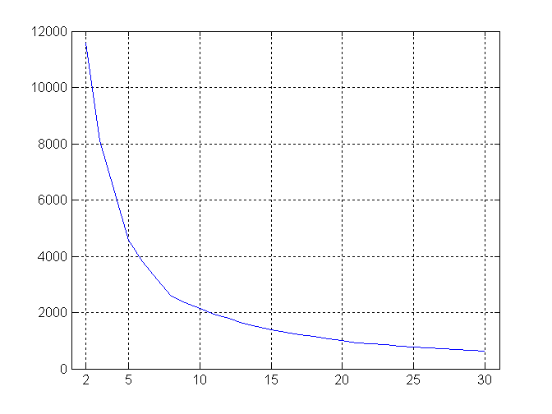
Internal Measures: SSE
SSE curve for a more complicated data set
SSE of clusters found using K-means

Slide 25
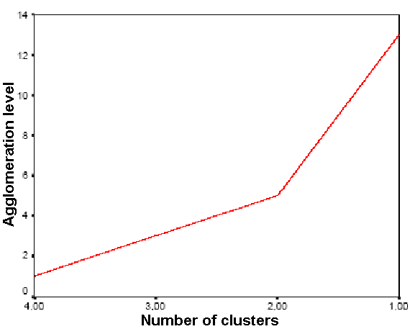
Inverse Scree Test
It is a plot with number of clusters on x-axis and agglomeration level on y-axis
Look for sharp increase – elbow knick

Slide 26
Supervised/External measures of Cluster Validation
Classification Oriented
Entropy, Purity, Precision, Recall and F-measure
Similarity Oriented
Involves comparison of two matrices
Ideal Cluster Similarity Matrix
Ideal Class Similarity Matrix

Slide 27
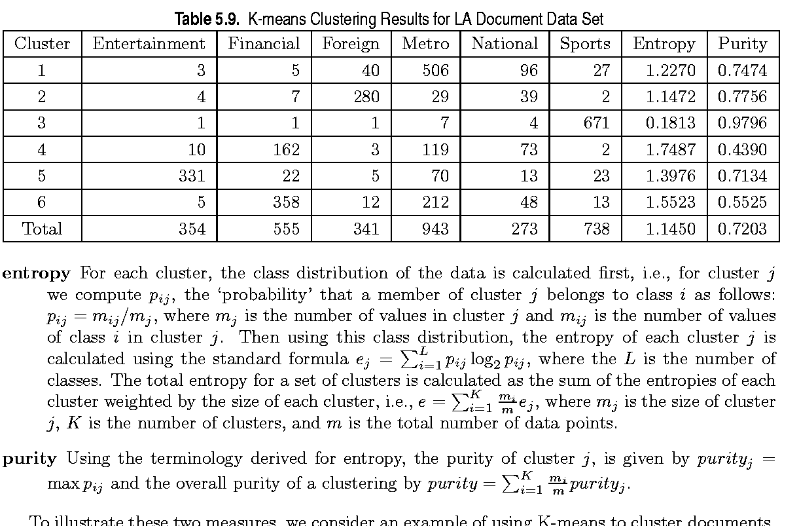
External Measures of Cluster Validity: Entropy and Purity

Slide 28
Unsupervised measures of Cluster Validation
Measuring Cluster Validity via Correlation

Slide 29
Measuring Cluster Validity Via Correlation
Two matrices
Proximity Matrix
“Incidence” Matrix
One row and one column for each data point
An entry is 1 if the associated pair of points belong to the same cluster
An entry is 0 if the associated pair of points belongs to different clusters
Compute the correlation between the two matrices
Since the matrices are symmetric, only the correlation between n(n-1) / 2 entries needs to be calculated.
High correlation indicates that points that belong to the same cluster are close to each other.
Not a good measure for some density or contiguity based clusters.

Slide 30
Correlation
Correlation measures the linear relationship between objects
To compute correlation, we standardize data objects, p and q, and then take their dot product
p
′
=
(
p
−
mean
(
p
))
/
std
(
p
)
k
k
q
′
=
(
q
−
mean
(
q
))
/
std
(
q
)
k
k
correlatio
n
(
p
,
q
)
=
p
′
•
q
′

Slide 31
Measuring Cluster Validity Via Correlation
Correlation of incidence and proximity matrices for the K-means clusterings of the following two data sets.
Corr = -0.9235
Corr = -0.5810

Slide 32
Using Similarity Matrix for Cluster Validation
Order the similarity matrix with respect to cluster labels and inspect visually.

Slide 33
Using Similarity Matrix for Cluster Validation
Clusters in random data are not so crisp
DBSCAN

Slide 34
Using Similarity Matrix for Cluster Validation
Clusters in random data are not so crisp
K-means

Slide 35
Using Similarity Matrix for Cluster Validation
Clusters in random data are not so crisp
Complete Link

Slide 36
Using Similarity Matrix for Cluster Validation
DBSCAN

Slide 37
Framework for Cluster Validity
Need a framework to interpret any measure.
For example, if our measure of evaluation has the value, 10, is that good, fair, or poor?
Statistics provide a framework for cluster validity
The more “atypical” a clustering result is, the more likely it represents valid structure in the data
Can compare the values of an index that result from random data or clusterings to those of a clustering result.
If the value of the index is unlikely, then the cluster results are valid
These approaches are more complicated and harder to understand.
For comparing the results of two different sets of cluster analyses, a framework is less necessary.
However, there is the question of whether the difference between two index values is significant

Slide 38
Statistical Framework for SSE
Example
Compare SSE of 0.005 against three clusters in random data
Histogram shows SSE of three clusters in 500 sets of random data points of size 100 distributed over the range 0.2 – 0.8 for x and y values

Slide 39
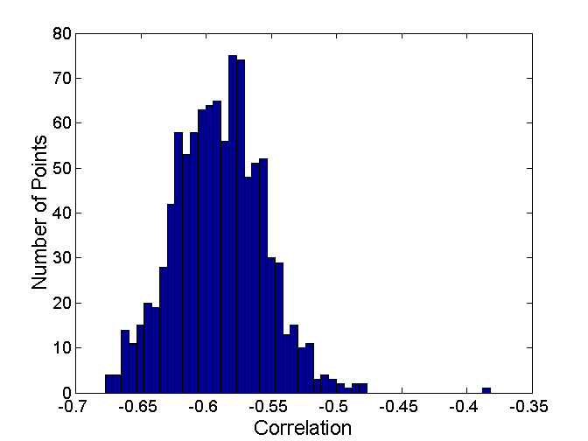
Statistical Framework for Correlation
Correlation of incidence and proximity matrices for the K-means clusterings of the following two data sets.
Corr = -0.9235
Corr = -0.5810

Slide 40
Final Comment on Cluster Validity
“The validation of clustering structures is the most difficult and frustrating part of cluster analysis.
Without a strong effort in this direction, cluster analysis will remain a black art accessible only to those true believers who have experience and great courage.”
Algorithms for Clustering Data, Jain and Dubes

